Slide 1
TEAM NAME : LOGIC LEGENDS TEAM LEADER : MONIKA B TEAM MEMBER : RESONA J PROBLEM STATEMENT: A web app that predicts fish species from images and generates informative reports using deep learning.

Slide 2
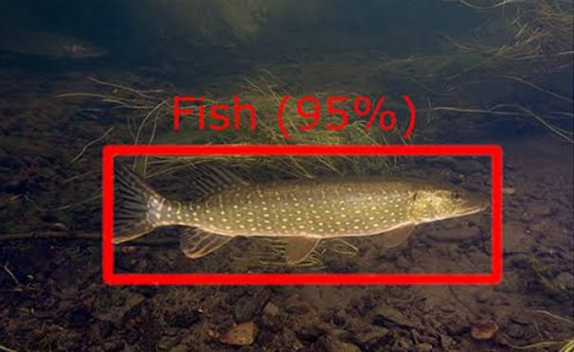
INTRODUCTION
Identifying fish species manually can be a time-consuming and error-prone task especially for marine biologists and fishing industries .
To address this ,our project presents an intelligent web-based system that automatically predicts fish species from images using a trained deep learning model.
The system enables users to upload an image of a fish , get an accurate species prediction , view detailed biological information and download a professional PDF report . It also includes modern UI features like image preview , chatbot for assistance.

Slide 3
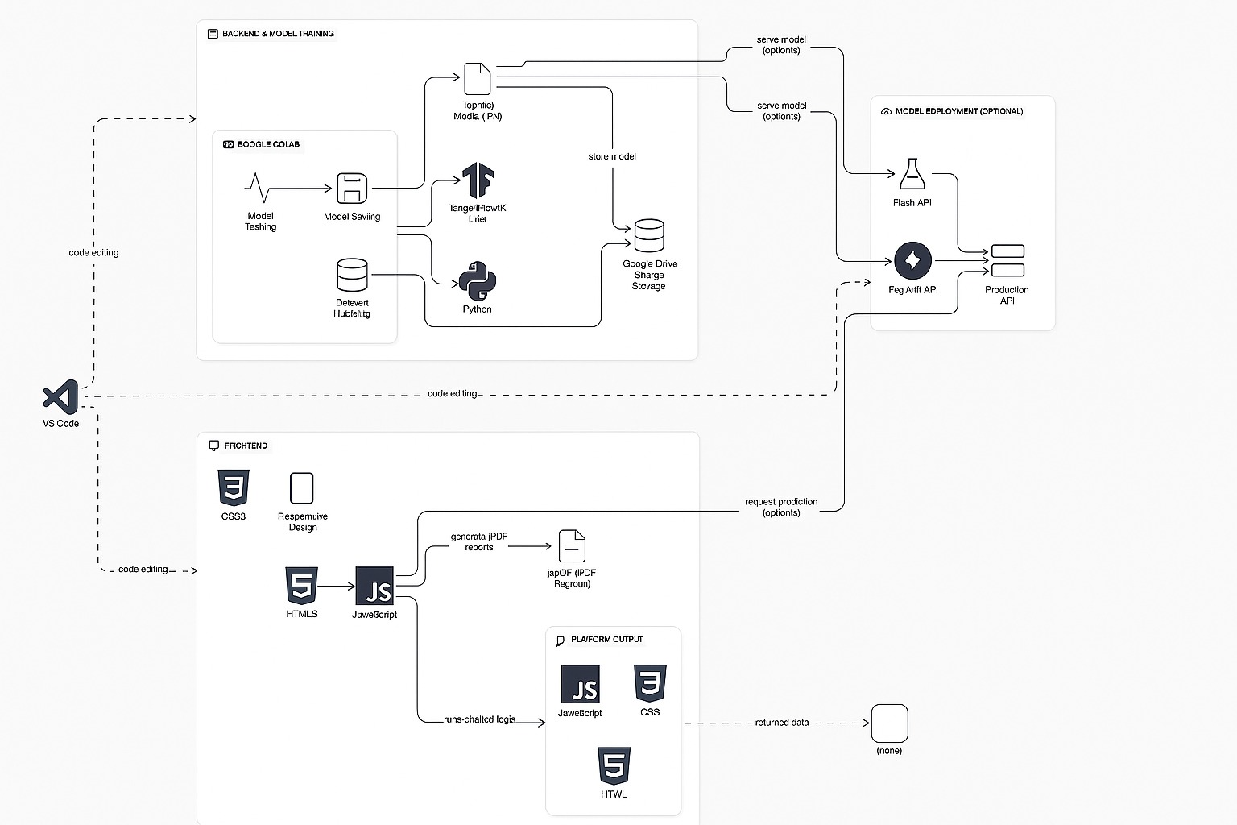
TECHNICAL STACK
FRONTEND
HTML5
CSS3
JAVASCRIPT
BACKEND
Python + Flask
TensorFlow / Keras
MODEL TRAINING
Google Colab
Dataset Source: Kaggle
OpenCV / NumPy / Pandas
REPORT GENERATION
TEMPLATING
Jinja2
jsPDF

Slide 4
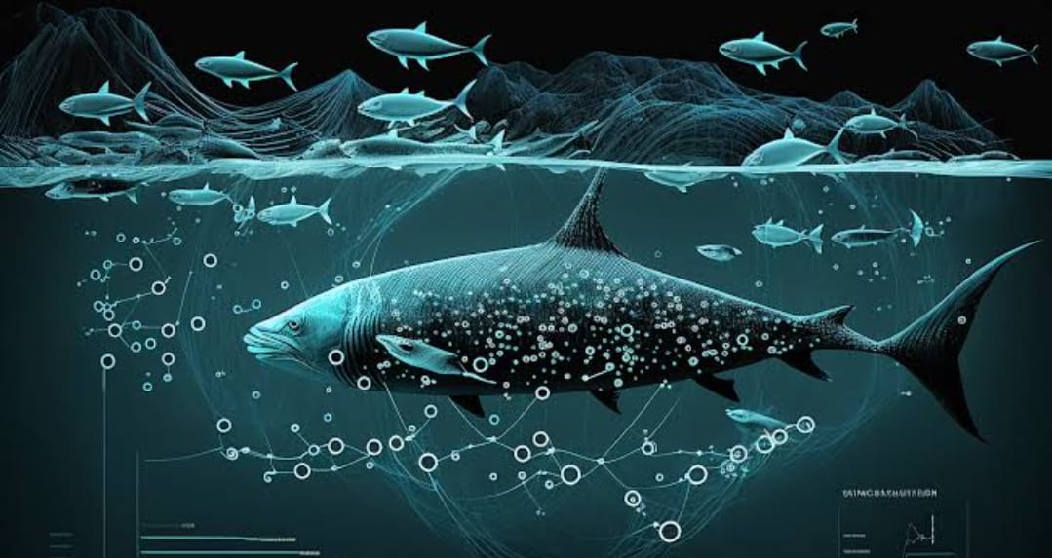
PROTOTYPE
YOUTUBE DEMO LINK
https://youtu.be/Q6-3p0HvxOE?si=sNGe8Pjz0ZDeEc-s

Slide 5
BUSINESS ANALYTICS
SECTION | PURPOSE
Business Objective | Defines the goal and real-world value the project aims to deliver.
Target Users | Identifies the primary users who benefit from the system.
Business Benefits | Outlines how the application adds value to users or stakeholders.
Key Performance Indicators | Lists measurable metrics to evaluate the success and efficiency of the system.
Growth Potential | Highlights future expansion opportunities for the product or platform.

